Slide 1
Session 2
Covers module 2 and 4 on the study guide

Slide 2
What is a citizen? Are you a good one??
Someone born in the US or “naturalized”…means they go through classes and a test to become a legal citizen
GOOD OR BAD…YOU DECIDE
Your mom gets a letter in the mail saying she has to serve on a jury, and she throws the letter away…
Your parents vote for the next FL governor
Your parents drive 100 miles per hour on I-4
You and your friends volunteer to help clean up the trash in a park
You and your friends volunteer to read to kids at the local library

Slide 3
Bill of rights
What are they?
The first ten amendments of the constitution that guarantee basic rights
What ones can you remember…
How are amendments made?
Step one 2/3 of congress must propose the amendment
Step two ¾ of states must ratify (approve) the amendment

Slide 4
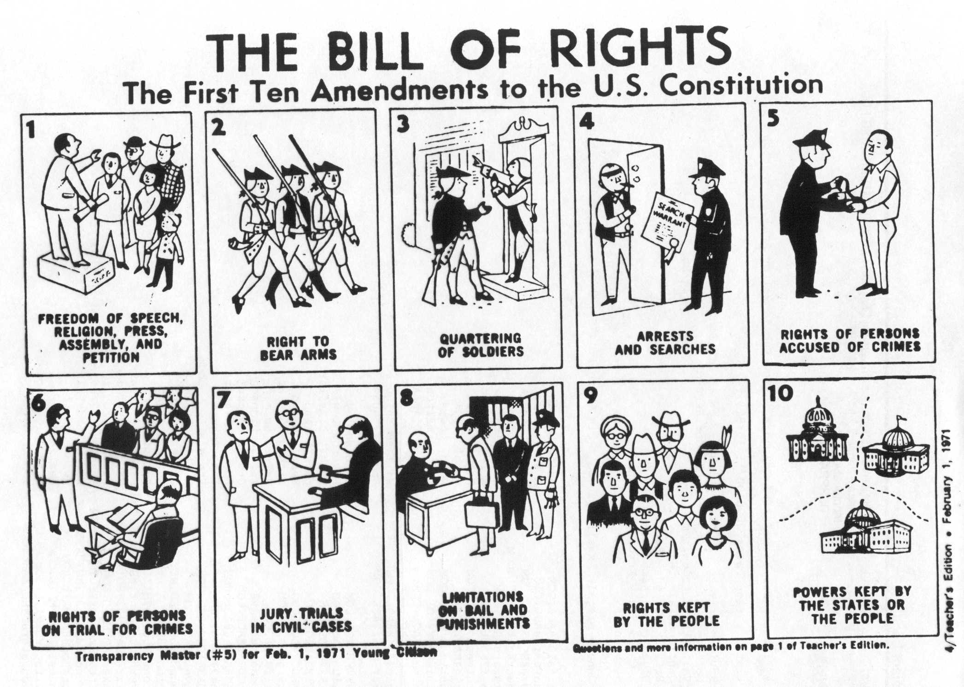

Slide 5
Jury duty WOO HOO!
What is it?
In a trial citizens are asked to be a part of a group of people who decide if the person is innocent or guilty
Why do we have juries?
A jury is designed to let people be judged by a non bias group of their peers

Slide 6
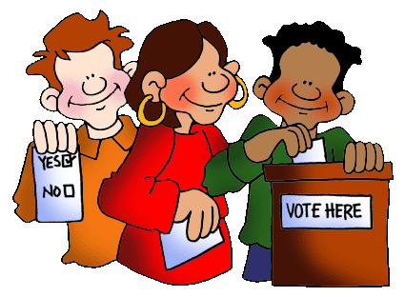
Elections…what in the world?
Political parties
Two main parties: republican and democrat
Voting
Need to register to vote with your area
Campaigns
When a person decided to run for political office, they promote themselves and their ideas to the public
Media impact
Political ads (can show one side of a story or be negative), campaigns covered by TV, newspapers, and internet sites

Slide 7
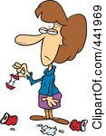
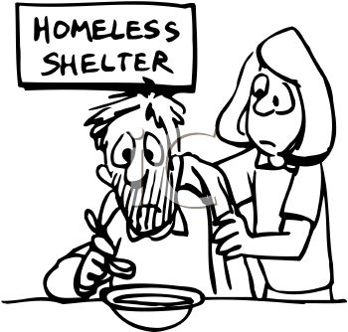
Is your community falling apart???
What is service? What are some examples?
Helping your community and donating your time
Volunteering with a food bank, picking up trash in a park, visting a retirement community…
What are some problems that our state and community have?

Slide 8
Policy…what is that?
Foreign policy
Laws that will effect other countries
Healthcare, education,
Domestic policy
Laws that effect people inside a country
Terrorism, global diseases

Slide 9
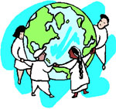
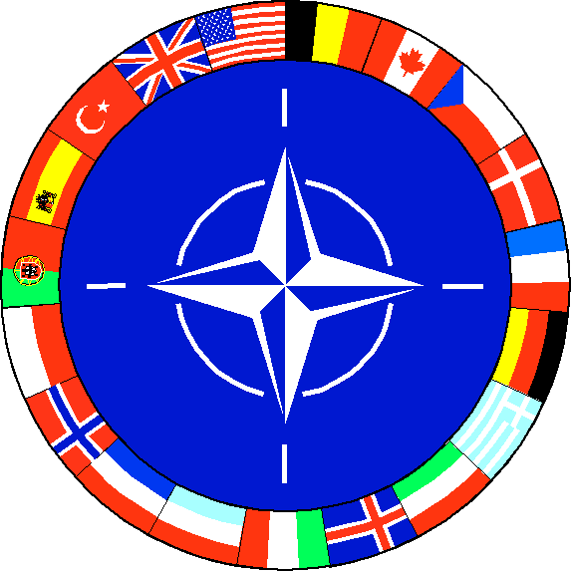
Over where? OH…overseas…
What is an international organization?
Organized group that countries join to work together
Peace corp, united nations,
Why do we (or any country) want to work with other countries?
Prevent wars, create better economy, trade with other countries

Slide 10
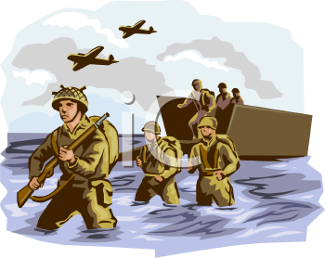
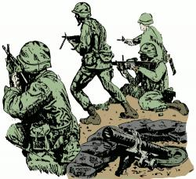
Don’t make me MAD!
What are some international conflicts we have been in?
Vietnam war, Korean war, world war 1 and 2
How does the US try and resolve fights with other countries?
Government changes, negotiation with leaders, change of leaders, teaching citizens how to fix their country…

